Slide 1



ENGLISH SECTION (2024-2025)
CMDC
Credit-bearing courses
20+ discussion items and 10 courses reviewed
Ellie, Caleb, Ashley, Nancy, John, Angus
University English II
New course offerings (service-learning) and changes in coordination.
Simon, Meilin, Louisa, Betty, Rita, John, Emma, Paul
Art of Persuasion
The materials have been further revised in accordance with feedback received, focusing on exemplar-based teaching and the implementation of Move structures.
Ellie, John, Louisa, Paul, Andrew, Emma, Betty, Simon (Departed colleague: Vince)
Enhancements include updated materials, better organization and the speech analysis tests.
John, Angus, Christopher, Rhett & Betty (Departed colleagues: Kate and Michelle)
Opportunities and Challenges
EEGC (UE0) has now become a prerequisite.
University English I
Significant changes to the curriculum: UEI being offered throughout the year UEII will be offfered in the second year.
Submitted a syllabus change that emphasizes an increased focus on AI in teaching and learning, along with the inclusion of argumentation models.
Leo, John, Rita, Ashley, Andrew, Angus, Oscar, Mable, Simon, Nancy (Departed colleague: Michelle)
Advanced English for postgrads
English-in-the-Discipline
New heights in figures and student numbers. Keep enhancing its services and exploring new service models. Improvements in IT may be necessary.
Nancy, Angus, Emma, Meilin, Simon, and contributions from other teachers.
New workshops, enhanced course focus, and new skills training.
Ellie & Meilin
Class size requirement has introduced fluctuations in teaching loads.
More non-jupas admissions could have implications on English proficiency.

Slide 2







FULFILLING NEW MISSIONS BY OCTOBER 2026
New initatives start in July, 2025
(after 18 months) and due Jan 2026
Outcomes expected by Oct 2026
‘A comprehensive strategy combining face-to-face teaching with AI tools for tutoring and feedback.’
‘Teacher feedback, AI-mediated strategies and peer-assisted models will be blended to optimise personalised and scalable language support.’
‘The flipped classroom model will engage students with technology-enhanced learning materials’
‘Creating informal, community-focused spaces for students’ language practice in student residences.’
‘Mastery of AI componential skills’
‘Documenting good teaching and learning practices and showcasing via appropriate channels’
Who assesses?
‘Capstone-specific language mentoring will offer personalised guidance for students’ project planning and revision, with co-assessment with subject teachers’
‘Immersive exchange programmes and virtual exchange opportunities connect students with the globe (internationalisation)’

Slide 3

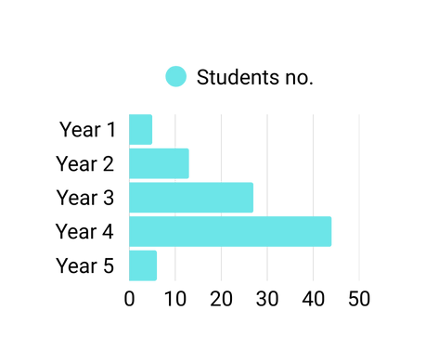

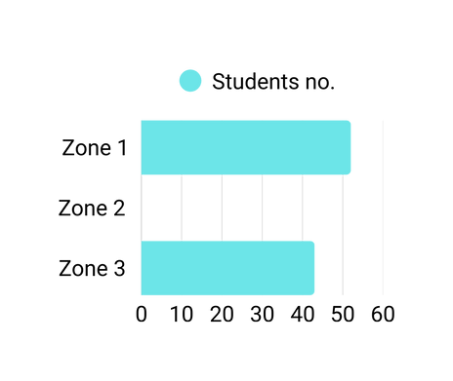
INTERCULTURAL IMMERSIVE EXCHANGE 2024-2025
Students applied: 129
Students got supported: 95
Pre-trip data: The students this year are highly motivated
Study years
1.
3.
Japan - 10
Malaysia - 1
Singapore - 6
S. Korea - 24
Sri Lanka - 1
Taipei - 1
Agency in different ratings
Intercultural awareness: 4.44/5
Language proficiency confidence: 4.14/5
Understanding of Sustainable Development Goals (SDGs): 4.31/5
News awareness: 4.25/5
Recognition of global citizenship importance: 4.44/5
Whole-person's mindset: 4.48/5
America - 2
Austria - 1
Berlin - 4
Brazil - 1
Canada - 3
Croatia - 3
Denmark - 5
France - 3
Germany - 12
Ireland - 3
Netherlands - 1
Poland - 1
Spain - 3
Tanzania - 1
UK - 9
Where did they go?
What do they mean?
The Intercultural Awareness items moved together the most strongly, meaning this theme is the most clearly defined pattern in students’ responses.

Slide 4
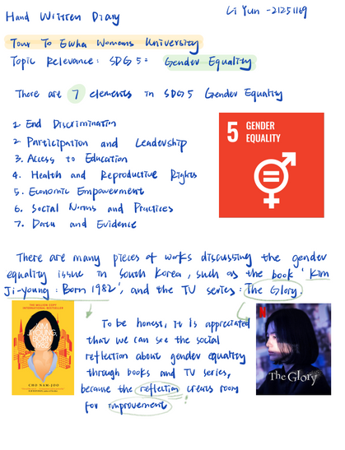

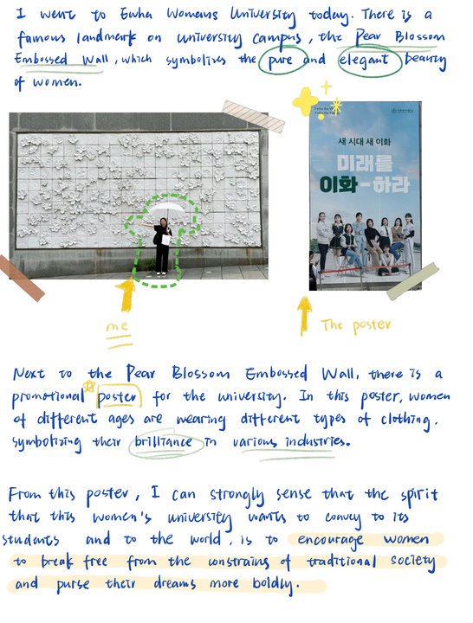

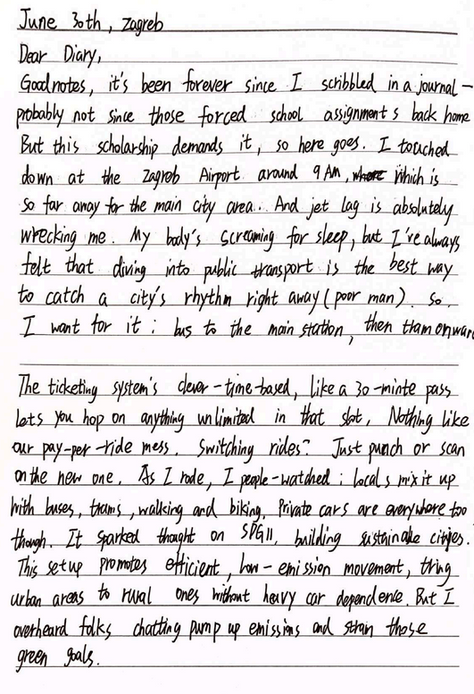
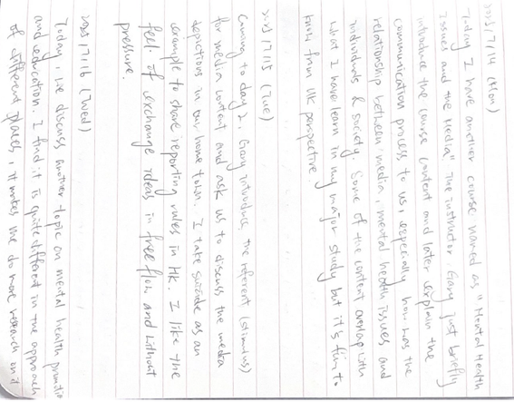
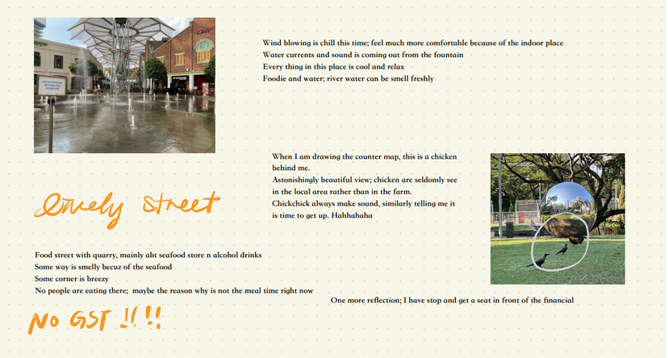
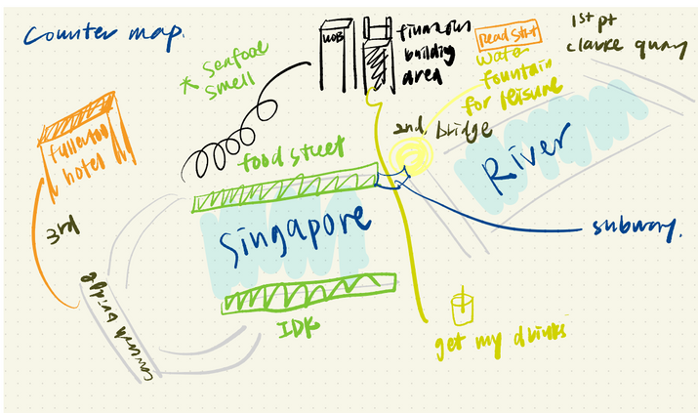
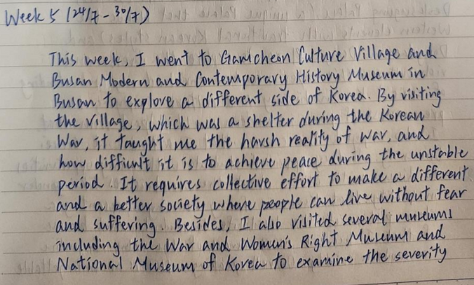
SAMPLE PRODUCTS

Slide 5
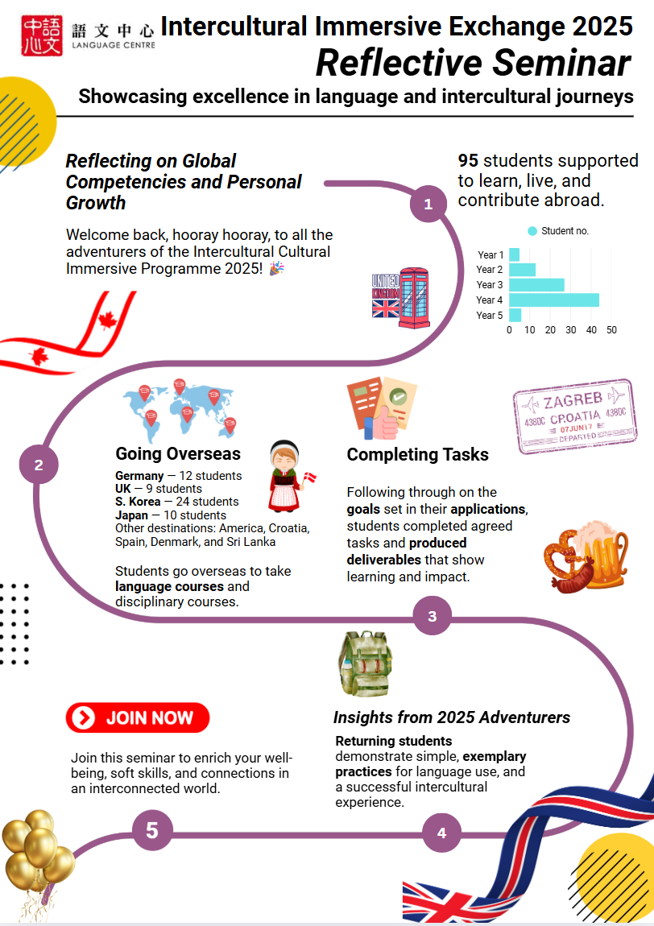

Slide 6

Learning for self-improvement
A greater commitment to civic engagement and global awareness.
Pre
Post
Enhanced confidence in dealing with cross-cultural situations
An awareness of global issues is important
Pre
Post
Community engagement is important
Increase in language proficiency and communication skills
Pre
Post
Not so important language skills
Post
Pre
Stronger understanding of SDGs
Introverted focus
Integrated focus o

Slide 7

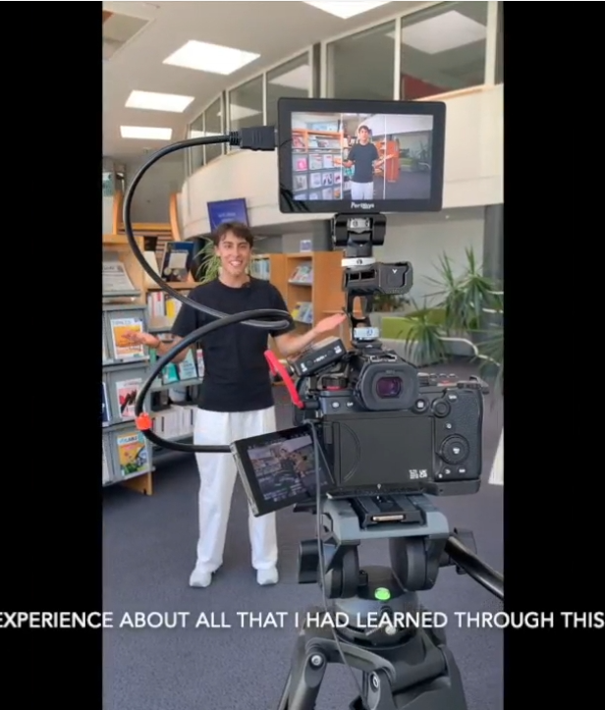


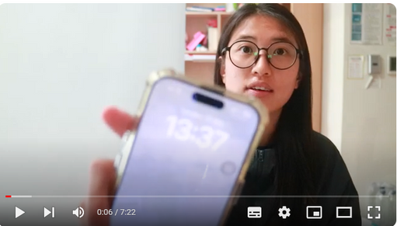

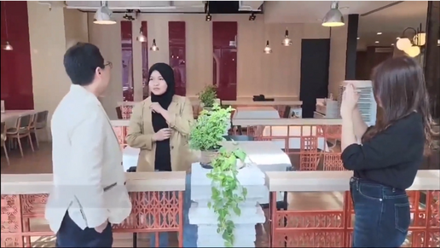
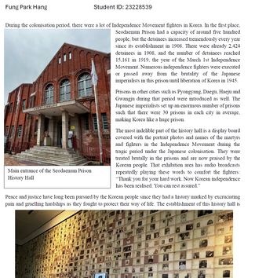
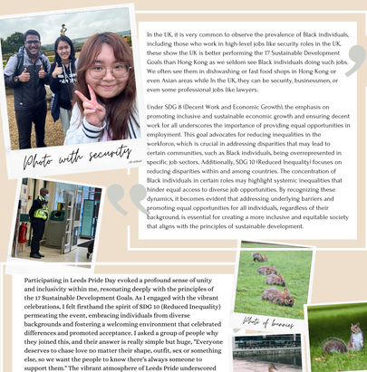
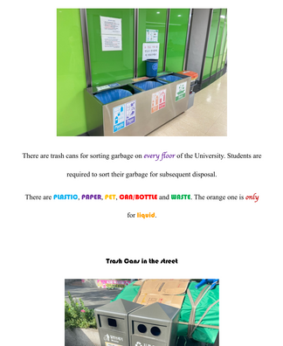
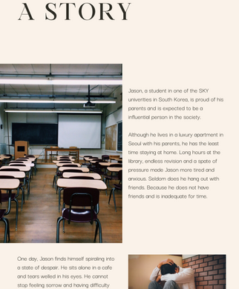
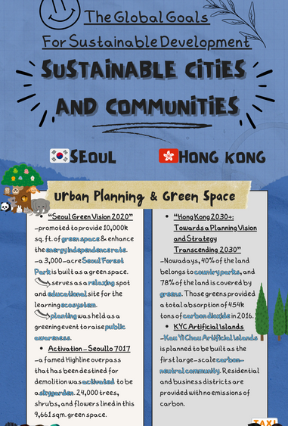

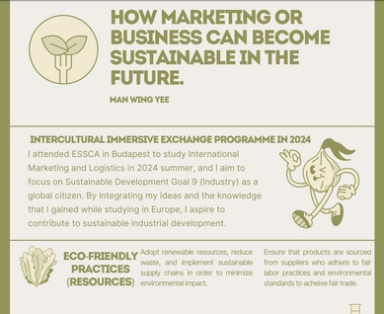
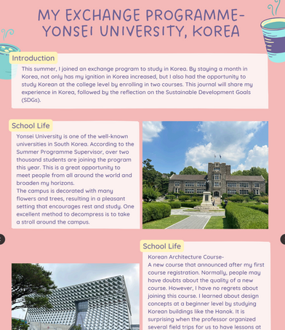

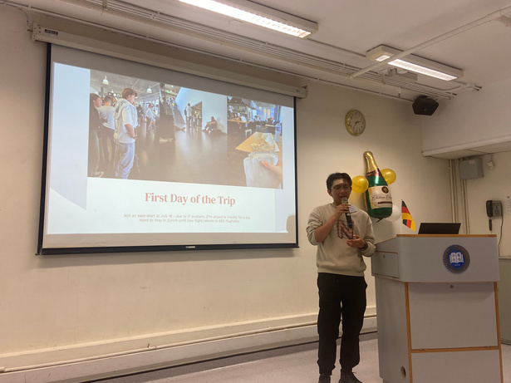
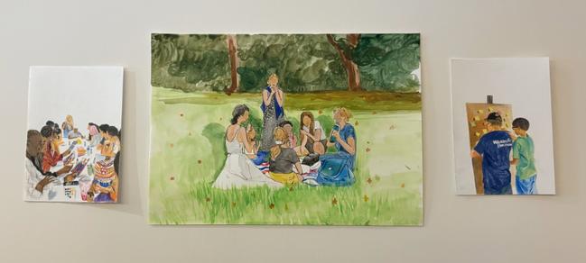

Students’ products after the summer programmes:
35 submissions of videos
25 submissions of photo journals and posters, as well as Instagram accounts
Other submissions include a novel and sketches with descriptions.

Slide 8

A Simple Method
1
On Environmental Responsibility:
2
On Gender Inequality
3
Engagement with Local Communities
During my time there, I engaged in various activities that enriched my understanding of resource management, particularly in the context of water management practices in both Chiang Rai and Rom Thai village in Chiang Mai.
"Witnessing firsthand how effectively Europe has protected and restored its coastal environments has really motivated me to advocate for similar conservation efforts back home."
"I realized that gender inequality is not just a South Korean issue; it is a global concern."
4
Witnessing Marine Conservation Efforts
5
Exploring Fast Fashion's Impact in Japan
6
Community Clean-Up in Singapore
5
A Simple Method
2
“I was encouraged to see the innovative ways people are working to conserve and restore marine life... From community-led mangrove rehabilitation projects to sustainable aquaculture initiatives.”
“As I learned more about the environmental issues tied to fast fashion—such as textile waste and carbon emissions—I felt a growing sense of responsibility."
"One pivotal moment was participating in a community clean-up event, where locals came together to maintain public spaces."

